Slide 1
360i Working Group
Analysis Concepts Update

Slide 2

Analysis Concepts Update – The missing link
USDM standardizes key elements of a protocol
Missing link: structured metadata for describing analyses
Analysis Concepts aim to fill this gap:
Framework for expressing clinical questions > analysis data and results
Support the creation of a digital Statistical Analysis Plan (eSAP)
Inform programming logic for analyses

Slide 3
Analysis Concepts Update – Goals
Interchange
Standardized structure allows interchange of analysis specifications between systems and organizations
Analysis automation and reuse
Machine-readable analysis specifications can directly link to statistical programming code reducing transcription errors, allowing automated validation and reuse
Reduced ambiguity
Standardized structure enforces precision in specifying analysis setting and assumptions
Increased traceability
Provides clear linkage from results all the way back to objectives and endpoints in USDM and vice versa
Streamlined collaboration
Provides common language between statisticians, clinicians, data managers, programmers and other stakeholders

Slide 4

Analysis Concepts Update – Topics covered
Analysis Concepts cover:
Analysis and creation of non-subject-level date (from ADaM to ARS)
Handling of subject-level data prior to analysis (from SDTM to ADaM)
Tentatively called Analysis Concepts (AC) and Derivation Concepts(DC)

Slide 5
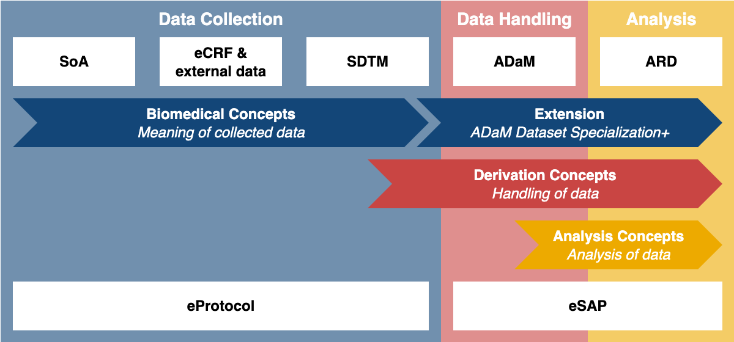
Analysis Concepts Update – How it fits in

Slide 6
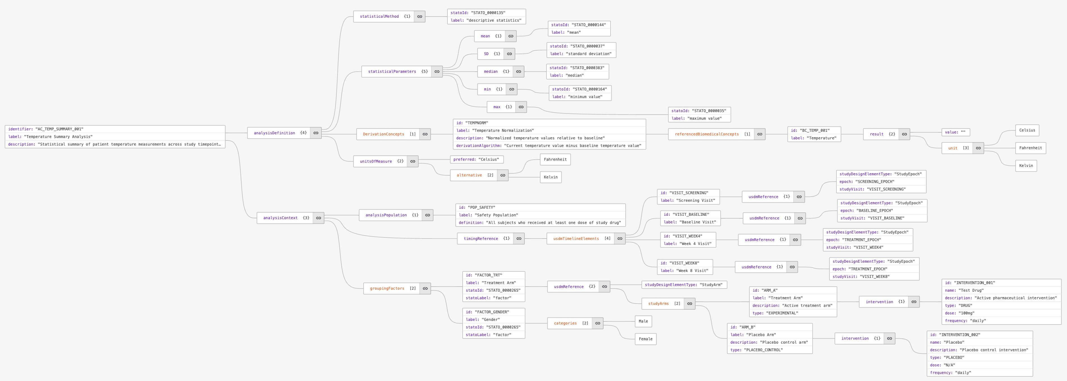
Analysis Concepts Update – Logical model
endpoint
BC
timing
statistical method
Change in ADAS-Cog at Week 24 based on an ANCOVA model, which includes the
baseline score, site, and treatment as continuous variable
covariates

Slide 7
Analysis Concepts Update – Start
Working Group formed in January 2025
Meet every Wednesday for 1 hour
Small group to gain momentum, to be extended when ready for prime time
Bess LeRoy (CDISC) | Kirsten Langendorf (data4knowledge)
Bhavin Busa (Clymb Clinical) | Linda Lander (CDISC)
Brian Harris (AstraZeneca) | Peter Van Reusel (CDISC)
Cedric Davister (Merck) | Richard Marshall (CDISC)
Edwin van Stein (CDISC) | Stuart Malcolm (Veramed)
Jeremy Teoh (Lindus Health) | Warwick Benger (GSK)
Karl Wallendszus (Oxford University)

Slide 8
Analysis Concepts Update – AC plan
Subset SAPs
Extract the primary analysis description
Use a script to download and parse SAPs
Tokenization and Pattern Recognition
Tokenize text into meaningful components
Identify common patterns
Iterative Modeling
Template Development
Visualize relationships
Refine based on new feedback and examples
Build generalized model of analysis concepts using tokenized elements
Compare and validate against existing models (USDM, ARS)
Common analyses
Software agnostic

Slide 9
Analysis Concepts Update – Progress
AC: subset SAPs
AC: tokenization and pattern recognition
Investigating how it fits in with USDM
Discussing fundamental assumptions
Investigating Statistical Data and Metadata eXchange (SDMX)
Investigating existing ontologies such as STATO

Slide 10
Analysis Concepts Update – Work ahead
AC: iterative modeling
AC: template development
Investigate DC model (structure, properties, executability)
Investigate how it fits in with ARS
Investigate PoC 360i (automation through USDM/BC > DC > AC)
Investigate if and how to make an eSAP

Slide 11
Analysis Concepts Update – Learn more
Learn more in Session 5 Track A (Tuesday 9:00-10:30 Symphony I)
Analysis Concepts Definition: Initial Perspectives from the CDISC Working Group
Bhavin Busa, Clymb Clinical & Brian Harris, AstraZeneca
Join the discussion in Session 6 Track A (Tuesday 11:00-12:30 Symphony I)
360i Roundtable & What’s Next
Peter Van Reusel, CDISC & Edwin van Stein, CDISC
Learn more at PHUSE EU Connect 2025
Abstract submitted for PHUSE US Connect 2026

